Slide 1

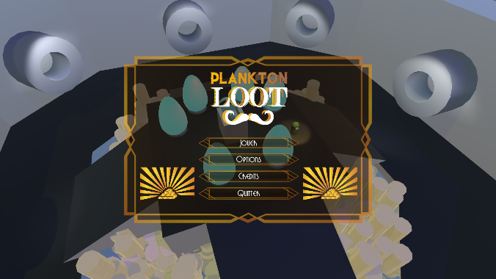

Project scope
1st year at ISART
Stealth game, failure in one shot
6 levels, 2 min each
Collaboration with programmers
Notes:
Arthur
Our end of year project, plankton loot, madein collaboration with progs. stealth game, unity, failure one shot, 1 level for each designer + a tutorial

Slide 2


Synopsis
To save his son, the player must steal a lot of money and 6 Light Eggs from Flooze Manor.
Flooze Manor, inhabited by rich old ladies
Served by Alfred Buthler
Their grandkids are also there
Notes:
Tiph
Arsène Plankton needs to save his son by robbing Flooze Manor. The characters are such and such

Slide 3

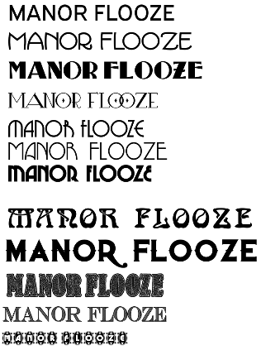
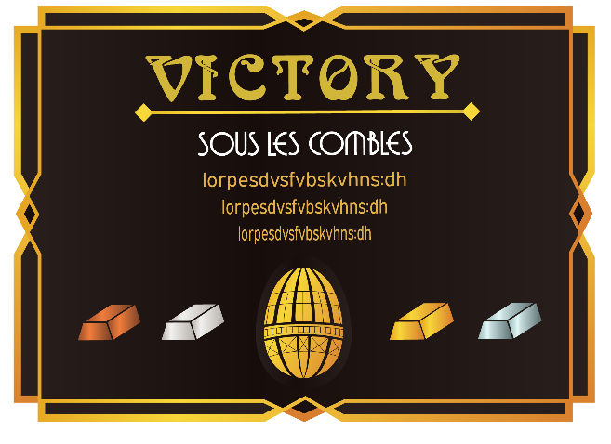
Visual mood
Cartoon Arsène Lupin & sound
Art style: Art Nouveau
Notes:
Arthur
We chose an art nouveau art style with a cartoon twist. You can see we had a lot of fonts to choose from.

Slide 4
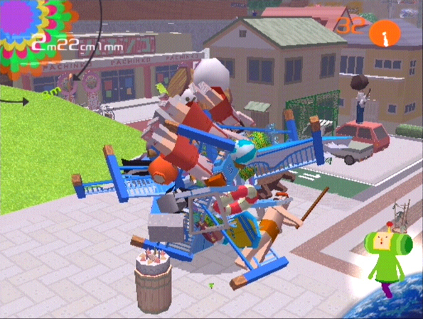
Design: Other inspirations
Katamari Damacy inspirations
Sound & modeling conveys the mood
Notes:
Tiph
We wanted the game to be funny and make people laugh. the gameplay is inspired by katamari.

Slide 5
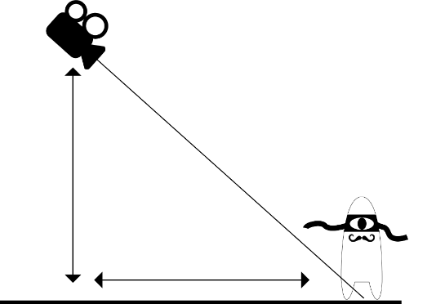

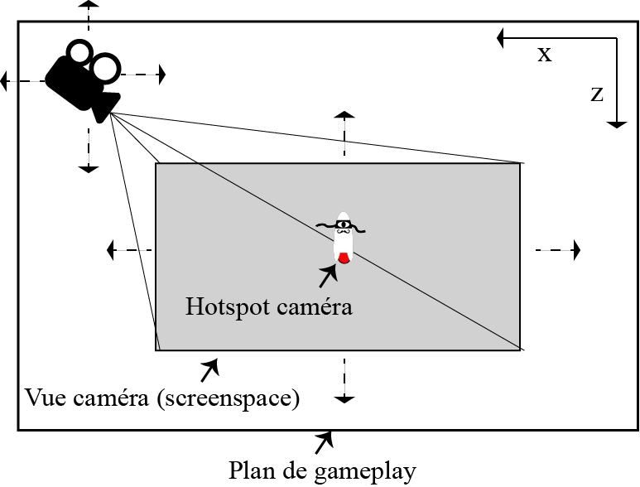
3C – Camera, controls
3rd person camera
Top down
Xbox pad support
Notes:
Arthur
The camaera looks down on the player
Game is played on an xbox pad

Slide 6
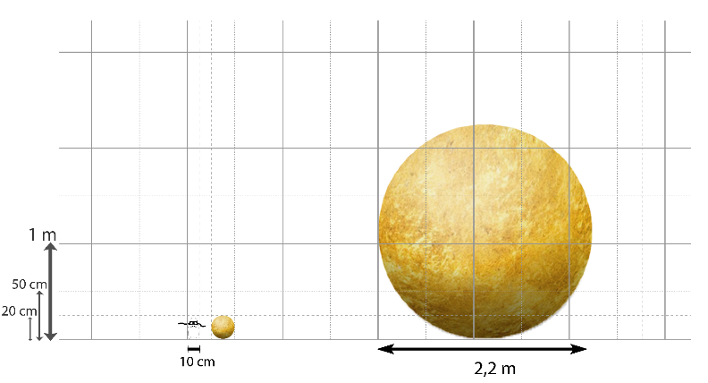

3C - Character
Arsène Plankton
Thief
Polite and efficient
mustache
Notes:
Tiph
Arsène Plankton, gentleman thief
Saves his son and his marriage through stealing lots of money

Slide 7
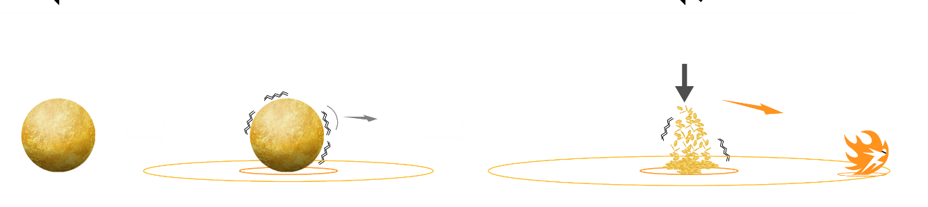
3C - Character
Skills:
Grow
Shrink
Dash
Notes:
Arthur
Pick up money or drop it and do stuff

Slide 8
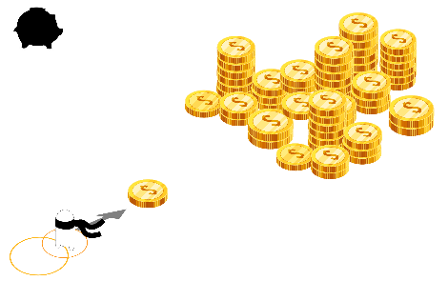
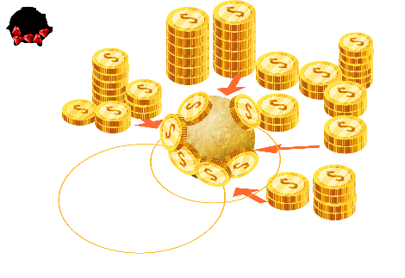
Design : Special Feature, Rewards
Risk / Reward as the core of our game
Rewards:
Small = fast
Big = heavy enough to trigger plates
Notes:
Tiph
Picking up money is the core of the game
It is needed by the player to progress
but picking up more money leads to risky situations

Slide 9
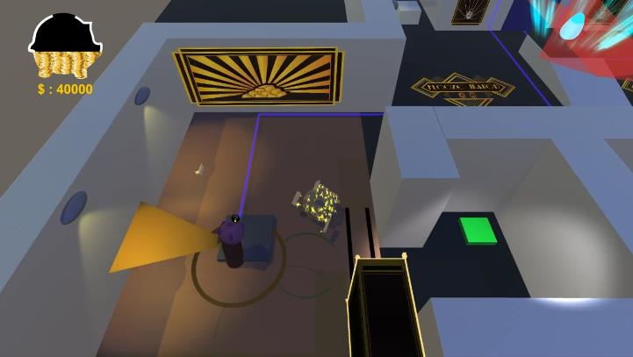
Design : Special Feature, Risks
Risks:
Too big = slow and noisy!
Too small = can’t progress!
Notes:
Arthur
Being too big is dangerous
Being too small prevents you from smashing doors or triggering pressure plates

Slide 10
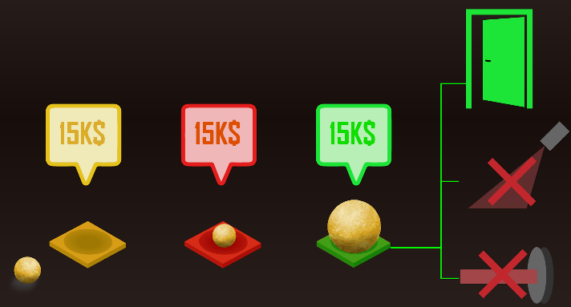
Design : Special Feature, Environment
Activate pressure plates!
Push doors and bookcases!
Climb in vents!
Notes:
Tiph
Gaining or losing weight allows the player to reach different paths and interact with differents elements

Slide 11
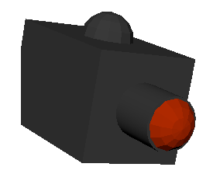
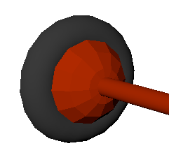
Obstacles
Cameras and lasers
Can be deactivated
mobile or immobile
no life zone
Cameras are a timing challenge
Notes:
Arthur
We also had ifxed obstacles with various qualities

Slide 12
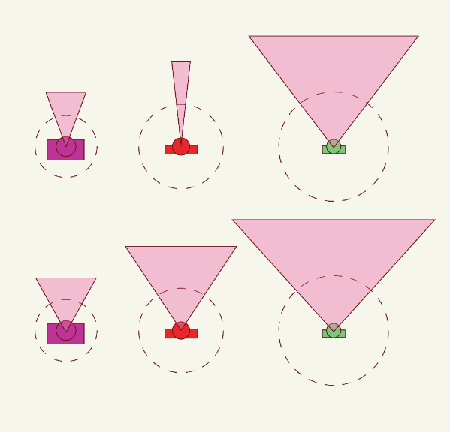
Enemy design
Granny
Alfred
Keed
Notes:
Tiph
we had 3 enemy designs, all different

Slide 13
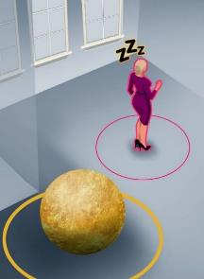
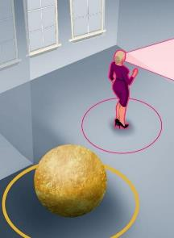
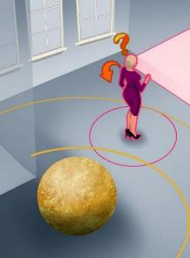
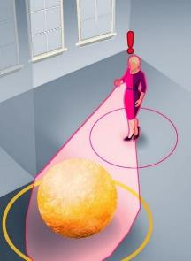
Enemy behaviour design
State machine design
Lots of iterations
Fine tuning required
Notes:
Arthur
We built flowcharts for how the enemies would react to hearing sound
Including a crazy animation of looking around like “what’s going on?”

Slide 14
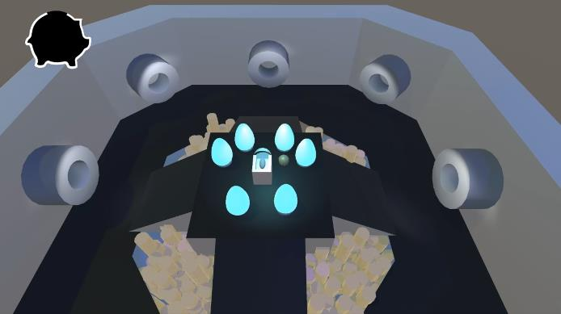

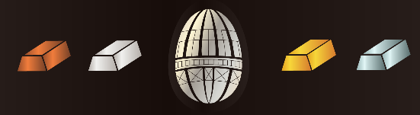
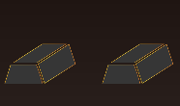
Design: scoring
Coins and gold ingots
Light Egg
Objectives
Evolving hub
Notes:
Tiph
The game revolves around scoring
The completionist aspect gives an incentive to players to get back to the levels after finishing them the first time

Slide 15
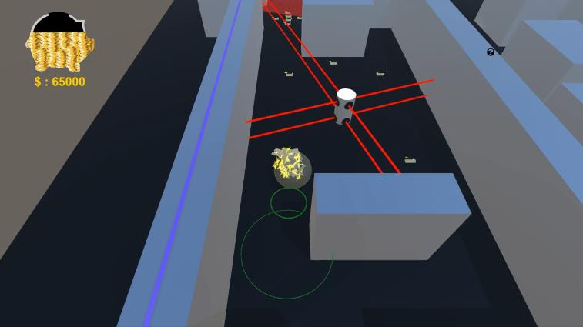
UI
Shows money collected
Visual representation of the player’s noise
Notes:
Arthur
Our UI is quite simple and shows only the amont of money collected
We also have visual cues for the amount of noise the player makes
and feedback on the enemies’ states

